Slide 1
TB Detection using X-Ray.
Solution to idea
Tech Stack
Features
Workflow
Demonstration
Presenter
Prikshat Manhas and Sonali Tandon

Slide 2

Project idea
The basic idea behind this module is to analyze the X-Ray images produced by the hospitals & other health care bodies to detect that whether the person is having TB or Not.
Features
Real time monitoring
New advancement to healthcare
Nearly accurate predictions
Can be used in many real life applications.
Can be deployed as Auto-AI where it will keep on updating with new data each time.

Slide 3


What is TB?
Tuberculosis (TB) is a potentially serious infectious disease that mainly affects the lungs. The bacteria that cause tuberculosis are spread from person to person through tiny droplets released into the air via coughs and sneezes.
Solution
Using a CNN we can develop a model that can analyze the X-Ray images of individuals.

Slide 4
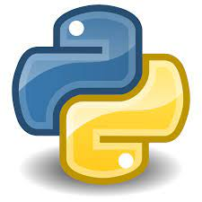

Tech Stack
Python – Deep Learning
OpenCV, Numpy, Pandas
Jupyter Lab
Dataset used for audio files:
China Data Set
'Montgomery - Labeled Set for TB
WORKFLOW
Input
Preprocessing
Image Size
Image Pixel
Feature Selection
Passing through model
Output.

